Slide 1
MODERN ERP
SELECT, IMPLEMENT, & USE TODAY’S ADVANCED BUSINESS SYSTEMS
CHAPTER 2:
ERP Technology
3rd Edition

Slide 2
Objectives
Understand the evolution of ERP architecture
Become familiar with relational database terminology, database relationships, and types of data stored in databases
Distinguish between customization and configuration of ERP software
Describe an ERP system landscape
Identify criteria for choosing between on-premise and cloud computing
Recognize ERP mobility issues

Slide 3
Evolution of ERP Architecture Mainframe Architecture
Mainframe architecture - all computing intelligence is within a central host computer that processes data and displays it on a “dummy terminal”
Users interact with the mainframe through a character-oriented terminal that captures keystrokes and sends the data to the host computer
Many companies still have systems built upon mainframe architecture

Slide 4
Client-Server
Client-server computing - a computing model in which tasks and workloads are partitioned between the client, which makes service requests and the more powerful server, which responds to the requests
Known as distributed computing because it consists of multiple software components on multiple computers that together run as a single system

Slide 5
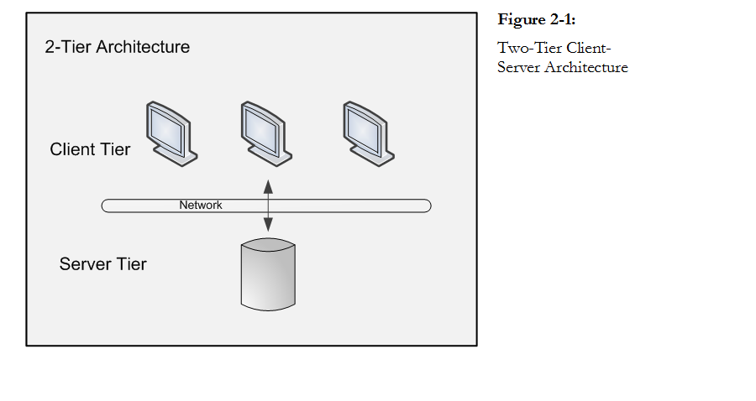
Two-tier Architecture
Two-tier architecture – comprised of the server which is often called the back-end application, and the client which is called the front-end application

Slide 6
Client-Server Logic
Presentation logic – designed for the display screens of a software application and is what makes the application respond to user commands
Manages the user navigation experience through a graphical user interface (GUI) so that the user can interact with the computer through icons, drop-down lists, and menus
Processing (or business) logic – manages communication between the GUI and the data storage
Storage logic - data storage and retrieval on the physical storage device

Slide 7
Fat/Thin Clients
Fat client - a client that can handle presentation and processing logic
Thin client - handles only the presentation logic
The fat server is responsible for the both processing logic and the storage logic

Slide 8
3-Tier Client Server
Three-tier client-server architecture - introduced one or more application servers between the client and the database tiers
Each tier contains code belonging to that layer
Advantages:
Better security
Maintenance becomes more manageable
Servers and clients can be added more easily as the business grows

Slide 9
Relational Database Management Systems
ERP systems use RDBMS to store enterprise data
Data is only entered once and shared across departments; the potential for errors and data duplication is reduced
Features include:
transaction mechanisms to enable concurrent access of the database
stored procedures to enforce business logic
security to limit access to parts and/or features of the database
ERP systems can generally use more than one type of database

Slide 10
Database Terminology
Data on an entity (something that can be uniquely identified) is stored in a two-dimensional table, which is called a relation
A field, represented by a column in the table, is designed to maintain certain information about every row in the table
Records, represented by rows in the table, are groupings of related fields

Slide 11
Entity Integrity Rule and PK
Each record must be identified by a unique attribute, called the primary key (PK)
usually a type of code either numeric or alphanumeric
Databases enforce unique identifier, known as the entity integrity rule. Rules for each record:
PK is unique
PK may not be null

Slide 12
Table Relationships
Foreign key (FK) - points to a PK in a different or foreign table and establishes and enforces a link between the data in the two tables
Entity Relationship Diagram (ERD) - a graphical representation of tables, most often used as the method for communicating between database designers and end users when developing databases
Three types of table relationships:
One-to-many
One-to-one
Many-to-many

Slide 13
One-to-Many Relationship
Each record of one table can be associated with zero, one, or many records in another table. Very common relationship

Slide 14
One-to-One Table Relationship
Each record in the first table is associated with only one occurrence in the second table, and each record in the second table is associated with only one occurrence in the first table.

Slide 15
Many-to-Many Table Relationship
A record in one table is associated with more than one record in a second table and
A record in the second table is associated with more than one record in the first table
Figure 2-7: Many to Many Table Relationship

Slide 16
Many-to-Many Relationship
To handle a many-to-many relationship, a separate table, called an associative entity (or junction table) separates the many-to-many relationship into two one-to-many relationships.
Each record in the associative entity table contains FKs from the two tables it joins.
Together, these two FKs become the PK in the associative entity in order to make each record unique. These two fields together are called a concatenated key.

Slide 17
Referential Integrity Rule
Referential integrity rule - a database constraint that ensures that relationships between tables remain valid and consistent
When one table is linked to another table through the PK/FK, referential integrity dictates that you may not add a record to the table that contains the FK unless there is a corresponding PK in the linked table
Also, you cannot delete a record in the PK table if that PK is a FK in another table.
Also, cannot change PK if change invalidates the link to data in the FK table

Slide 18
Database Normalization
Database normalization - a sophisticated process to structure fields and tables in a RDBMS
Eliminates redundant data
Ensures that data dependencies make sense by storing only related data in a table
Isolates data so that additions, deletions, and modifications to a field are made only in one table and then propagated throughout the rest of the database through relationships

Slide 19
Data Not Normalized
The data below is non normalized because there are repeating groups for Subject.
Another way data is not normalized is if there is variability in the number of fields or if fields contain multiple values.

Slide 20
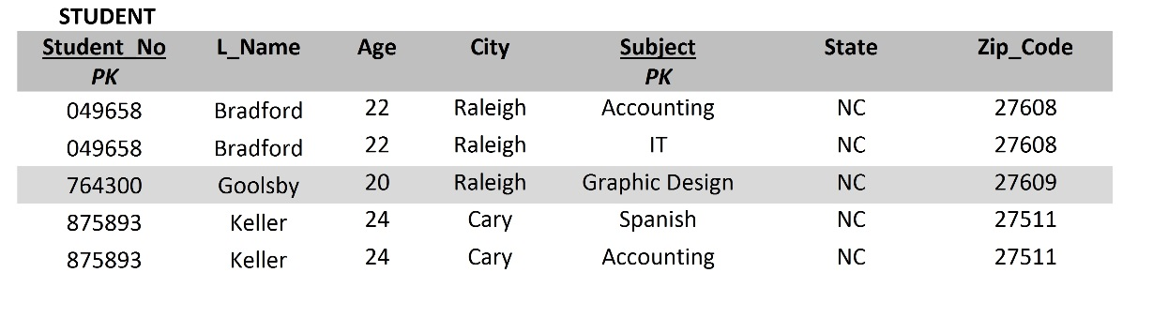
First Normal Form
First normal form (1NF) - deals with the “shape” of a record type. The data in this table is in 1NF because every field contains one value and nulls in fields are eliminated by making sure each repeating group attribute contains a data value. Also, all records have same number of fields.

Slide 21
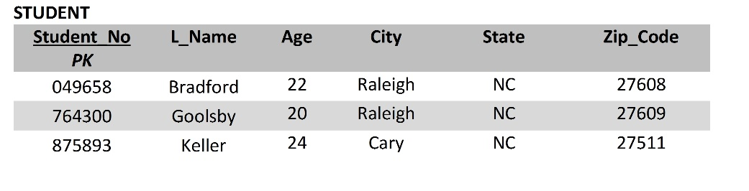
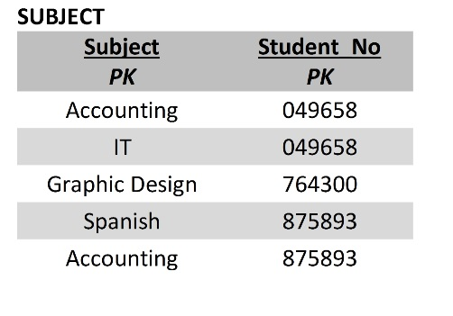
Second Normal Form
In 2NF the table is in 1NF, and all fields refer to/ describe the PK value. If the PK is based on more than one field, each non-key field must depend on the whole of the concatenated key, not just one field in the PK, a situation known as a partial dependency.

Slide 22
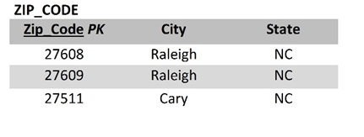
Third Normal Form
In 3NF the table meets 2NF requirements and all fields are mutually independent. Every non-key field is dependent only on the primary key.
Transitive dependency is when one or more fields in a table are not dependent on the PK but on another key known as a determinant.

Slide 23
Structured Query Language
Structured Query Language (SQL)- a special purpose programming language for communicating with an RDBMS
Most common command is a query, which allows the user to describe desired data

Slide 24
ERP Data
Master data - relatively permanent data collected on entities in the business. Remains stable over time but it can be edited.
Generally falls into four groupings: people, things, places, and concepts
Examples of master data include employee master, inventory master, department master, and licenses master

Slide 25
ERP Data
Transaction data - records of day-to-day business events
Highly volatile (unlike master data)
Transaction data accesses master data in order to process the event
A payroll disbursement is linked to a specific employee in the master data
Examples of transaction data include purchase orders, general journal entries, sales invoices, and payroll disbursements

Slide 26
ERP Data
Configuration data - enables a company to tailor a particular aspect of the system to the way it chooses to do business
Includes setting up enterprise structural details such as number and type of plants, sales organizations, warehouses, and distribution channels
Other examples: select fiscal year-end, default currency, and default language from various options allowed by the ERP system

Slide 27
Configuration
Configuration - the process of selecting parameters that enable a company to tailor a particular aspect of the system to the way it chooses to do business
System integrators and/or project team will configure the system during implementation
Examples: configuring accounting preferences, reversing entries, or to ‘enforce holds’
Options are stored as configuration data in configuration tables

Slide 28
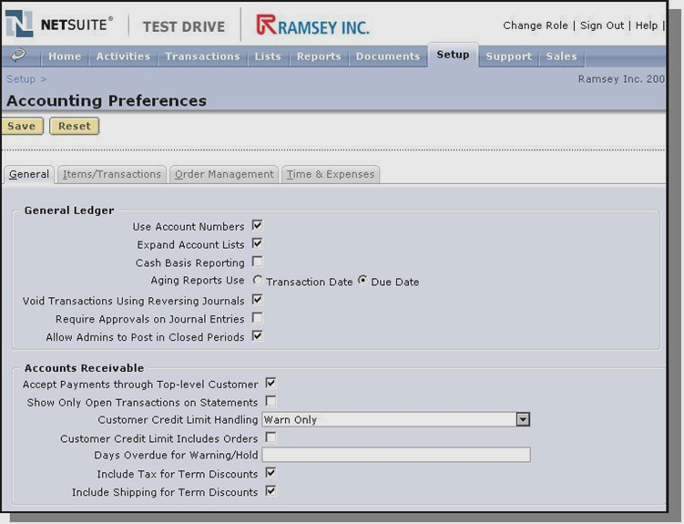
NetSuite Accounting Preferences

Slide 29
Customization
Customization - the process of fitting the ERP software to the specific needs of the organization by rewriting or adding code to the ERP software
Used for issues that fall outside the bounds of what the ERP software will allow a company to do through configuration
Examples:
A missing field or checkbox on a screen
A missing form
The need to link two records in a relationship that are not linked
A missing step in a workflow
A missing piece of functionality

Slide 30
Customization
Customization makes an implementation more expensive and time consuming
Larger companies are more prone to customize ERP than are smaller companies because:
they have the technical expertise to program and maintain the code
they have the monetary resources to fund customizations
their operations are more complex or unique, thus warranting a deviation from standard ERP code

Slide 31
Best of Breed
Best of Breed – companies “mix and match” modules from different software vendors in order to obtain (what they consider to be) the overall best ERP system
Middleware is software that facilitates sharing data and business logic across systems; requires a certain degree of IT support to set up and maintain

Slide 32
System Landscape
A system, or instance, is an installation of ERP software and the related components on a server or servers.
The system landscape is the “layout” or “architecture” of the servers.
To complete a landscape, companies will purchase multiple servers and install the ERP system and DB several times.

Slide 33
ERP Instances
Development (DEV) – The instance in which consultants/team configure and customize the system per the company’s requirements
Sandbox - area in the DEV environment where configuration and customization options are explored
Quality assurance (QAS)- customizations and configurations will be tested by end users or members of the project team during implementation
Production (PRD) - the live system users work with

Slide 34
Cloud Computing
Cloud computing - the ERP system and the associated data are managed centrally (in the internet "cloud") by the ERP vendor or third-party service provider and are accessed by the customer on demand
In cloud computing, companies make periodic payments to the vendor for software, infrastructure, and maintenance called software as a service (SaaS)
Service level agreement (SLA) - must spell out clearly what is being delivered, how it is to be measured and by whom, and what penalties will ensue if the SLA is not met

Slide 35
On-Premise ERP
On-premise - the ERP system is installed locally on a company’s own servers
Companies may choose on-premise when their business environment involves highly sensitive data and numerous, fast paced application changes or they have a high user base and rapidly changing user demands
Switching costs of going to cloud are too great for large companies

Slide 36
Cloud vs. On-Premise ERP Solution

Slide 37
Mobility
Mobility- the ability to access data and information from a computing device wherever and whenever needed.
Strategic approach to mobility
Serves the needs of those outside the organization, while reducing costs and improving process speed
Suitable for the “on-the-go” or occasional user
Consider security issues
Applications for minimal data entry and display
Example: time and expense reporting, sales and order entry

